Slide 1



Report on OpenDaylight (ODL) Plug-in for Padtec ROADMs
University of Campinas – Unicamp
School of Electrical & Computer Engineering – FEEC
Alaelson Jatobá¹, Darli Mello¹, Christian Esteve Rothenberg², Dalton S. Arantes¹, Sergio Timóteo³
¹{alaelson,darli,dalton}@decom.fee.unicamp.br
²{chesteve}@dca.fee.unicamp.br
³{sergio}@padtec.com.br
December 01, 2014.

Slide 2
Outline
Abstract;
Goals;
SDN System Architecture;
ODL Plug-in implementation;
Padtec NMS API and Architecture;
System Features;
Client Application;
Scenario at Super Computing 2014;
SC14 Results and Team.

Slide 3
Abstract
This work describes the software developed by Padtec and Unicamp for demonstration at Super Computing 2014 (SC14). The plug-in controls Padtec’s Reconfigurable Optical Add/Drop Multiplexers (ROADMs), providing support to software defined networking (SDN) using the OpenDayLight (ODL) controller. The main achievement was a peak rate of 1.55 Tbps provisioned using a third-part client application that sends commands to the ODL controller, increasing and decreasing the bandwidth as needed.

Slide 4
Goals
Maximize the wavelength utilization;
Reduces the blocking probability;
Assign appropriate routes and wavelengths over the lightpaths to maximize throughput;
Manage lightpath establishment in real-time;
Provisioning resources on demand (Manage connection request).

Slide 5

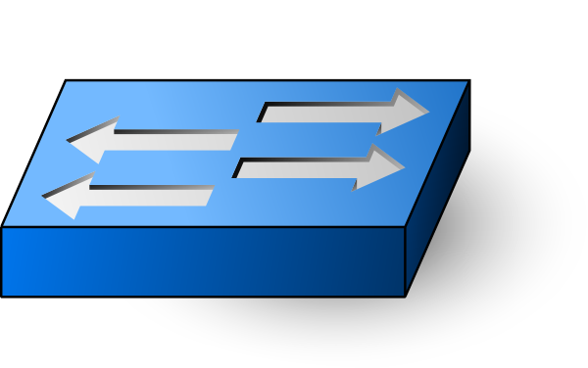
SDN System Architecture
Console Client
Caltech Fast Data Transfer
Rest
Rest
Rest
Orchestration
NB Caltech Plug-in
ODL NB Interface
SB Unicamp Plug-in
OpenFlow Support
Rest
OpenFlow
Switch
NB RESTful API
Padtec Mgmt Software
PADTEC ROADM
Padtec
Protocol

Slide 6
Implementation ODL Plug-in
Implemented by the Unicamp team based on Padtec NMS RESTFul APIs, abstracting the hardware complexity features of the ROADM device;
Offers to the user two simple methods (increaseBandwidth and decreaseBandwidth). Channel selection and other messages of Padtec’s management software are not exposed to the user;
Works as an OpenDayLight plug-in providing SDN programmability and orchestration to Padtec’s devices.

Slide 7
ODL Plug-in
Features:
Acts as a South Bound interface in the OpenDayLight;
Implements the RESTFul API to control the Padtec ROADMs;
Keeps a memory of the connection states;
Keeps a route table;
Implements the first-fit algorithm in order to choose the lambda to provision and remove channels;

Slide 8
ODL Plug-in
It is composed of two parts:
South Bound (SB): implements the required logic to use Padtec APIs and provides useful abstractions;
North Bound (NB): is a RESTFul interface to receive command from the clients.
Implemented by Caltech Team.

Slide 9
ODL Plug-in: Interaction with the client application
A RESTful North Bound Interface is used to integrate the client apps with the SDN controller.
Supported Commands:
useCache: is a boolean value to set if the cache memory and route table must be used;
increaseBandwidch – activates a channel between two nodes;
decreaseBandwidch – removes a channel between two nodes;
useExtreme: is a boolean value to set the Extreme switch to be used in Caltech Booth. It was a temporary feature developed during SC14.
getTopology: returns the network topology.
getNEs: returns the information about the network elements.

Slide 10
ODL Plug-in: Methods to increase and to decrease bandwidth
Increases the bandwidth between source and destination nodes;
To increase bandwidth, the channel is chosen using the first-fit algorithm in descending order, but to decrease bandwidth the algorithm uses the ascending order of channels;
If the client sets the cache memory on, the routes are fetched from cache, improving the performance of the system by reducing the amount of queries to get the routes from the Padtec´s Management Software through the RESTful APIs.

Slide 11
ODL Plug-in INCREASE BANDWIDTH
Use Cache?
START
no
Send get routes cmd to PADTEC Mgmt
CLIENT
save
return
yes
yes
REST COMMAND
Accept?
NB
cache
Route from src to dst
call method
return
FAIL
no
no
confirm?
Send command
to Padtec Mgmt
Make create-occupation JSON
Select channel from descending order
yes
SUCCESS

Slide 12
ODL Plug-in DECREASE BANDWIDTH
Use Cache?
START
no
Send get routes cmd to PADTEC Mgmt
CLIENT
save
return
yes
yes
REST COMMAND
Accept?
NB
cache
Route from src to dst
call method
return
FAIL
no
no
confirm?
Send command
to Padtec Mgmt
Make remove-occupation JSON
Select channel from ascending order
yes
SUCCESS

Slide 13
Padtec RESTful Architecture
Orchestration
NB Caltech Plug-in
ODL NB Interface
SB Unicamp Plug-in
OpenFlow Support
Rest
REST Interface API Features:
Topology Search;
ROADM Discovery;
CrossConect Traceability;
Paths Discovery and Monitoring;
Path Configuration;
NB RESTful API
Tomcat Web Server
RMI
Padtec Mgmt Software
PADTEC ROADM
Padtec
Protocol

Slide 14
Padtec RESTful North Bound API
Commands:
GET $SERVER_ROOT/rest/nes
GET $SERVER_ROOT/rest/ne-interface/$NE_ID
GET $SERVER_ROOT/rest/cossconnections/$NE_ID
GET $SERVER_ROOT/rest/topology
GET $SERVER_ROOT/rest/routes/$SOURCE_ID/$DESTINATION_ID
POST $SERVER_ROOT/rest/create-occupation/$SOURCE_ID/$DESTINATION_ID
POST $SERVER_ROOT/rest/remove/$SOURCE_ID/$DESTINATION_ID

Slide 15
System Features
Use network at full speed;
Dynamically monitoring the capability of the storage systems;
Dynamically monitoring the network path in real-time;
Dynamic Distributed Service Architecture;
Integration of existing monitoring tools (via APIs);
Routing and Wavelength Assignment (RWA).

Slide 16
Client Application
FDT - Fast Data Transfer from Server to Storage System;
Lightpath management;
Preventive network diagnosis;
Reads and writes coordinated, streams or a large set of files with smooth data flow across long-range networks;
Science programs handling hundreds of petabytes per year

Slide 17
Super Computing 2014

Slide 18
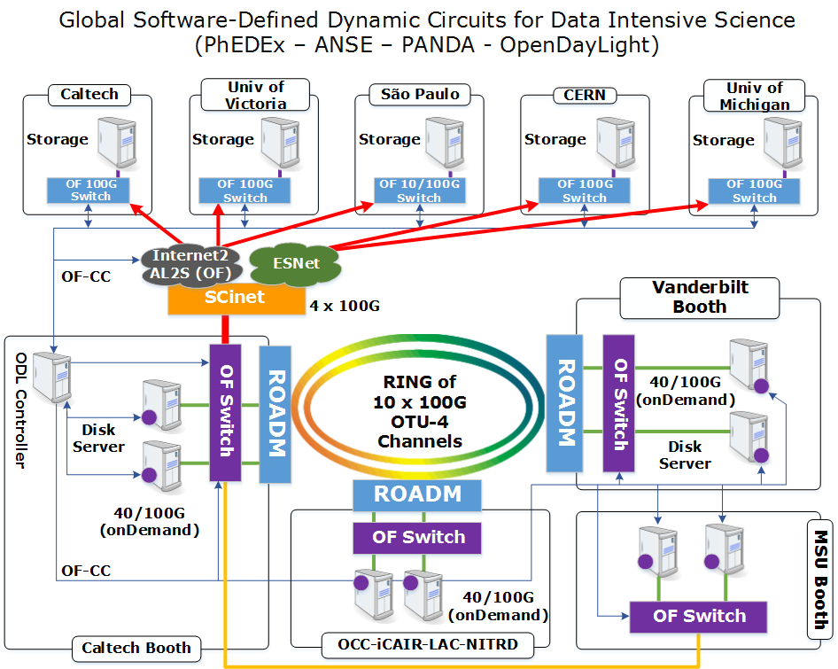
SC14 Complete overview

Slide 19
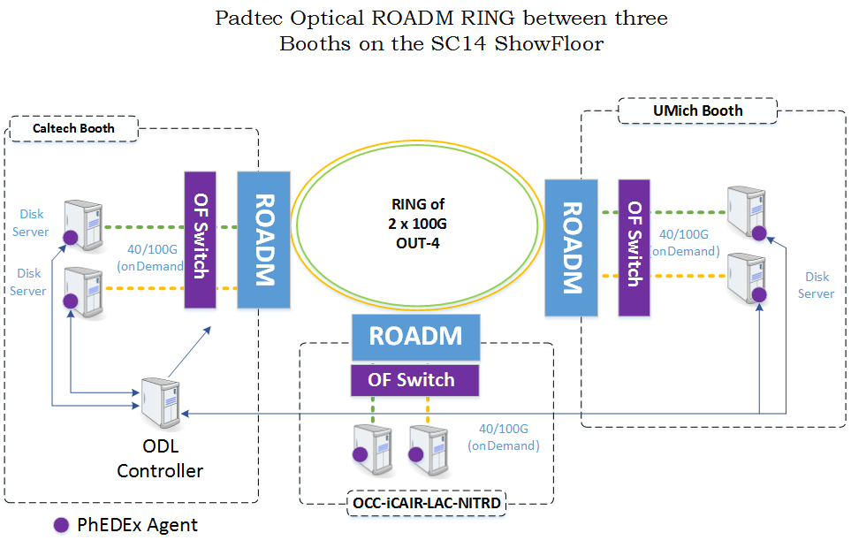
SC14 Complete overview

Slide 20
Network Interfaces used in the Showfloor
3 Booths in the showfloor:
Caltech: 10 x 100 Gbps
iCAIR: 6 x 100 Gbps
Vanderbilt: 4 x 100Gbps
Caltech booth has 2 switches
1 Brocade with 4 x 100Gbps
1 Extreme with 6 x 100Gbps

Slide 21
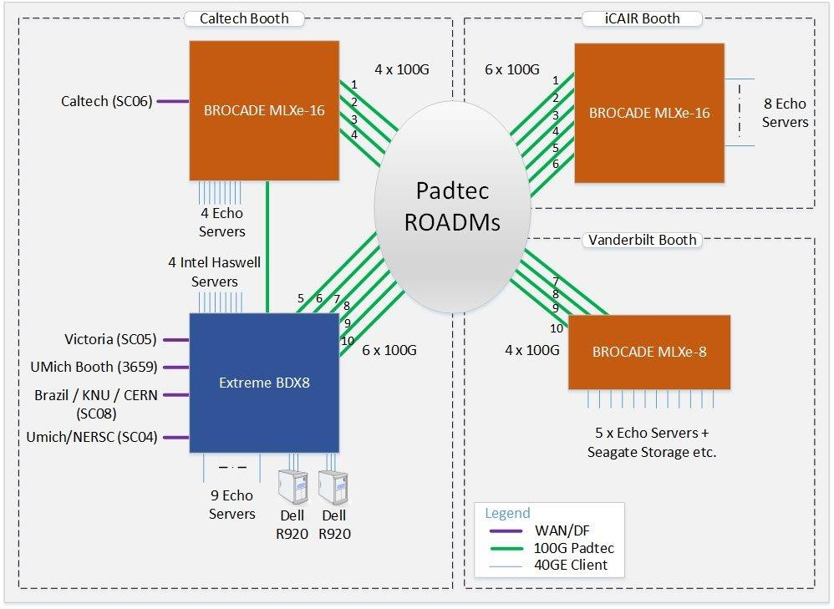
SC14 Demo Topology

Slide 22
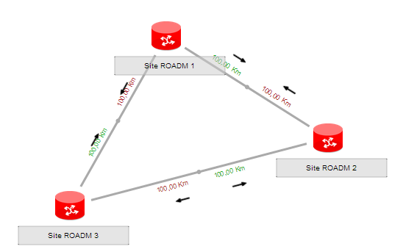
Padtec Directionless ROADM
10 Boards 100G OTU-4
C21 to C30
Direction C
Direction A
Direction B
Direction A
Direction C
4 Boards 100G OTU-4
C21 a C24
Direction B
Direction B
Direction C
10 Boards 100G OTU-4
C21 a C30
Direction A

Slide 23
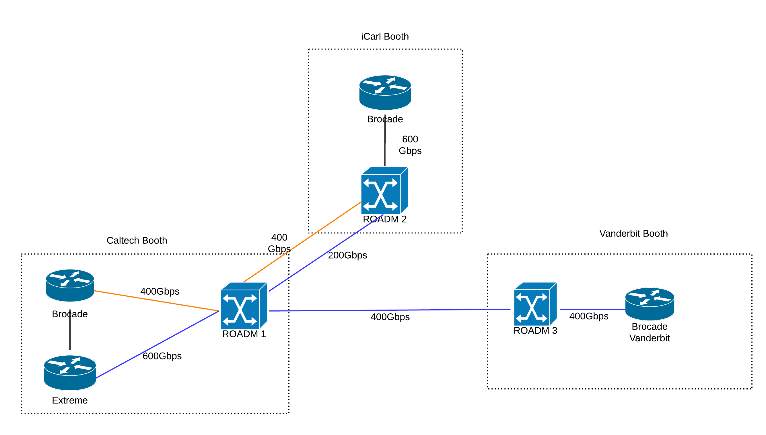
SC14 Demo Topology

Slide 24
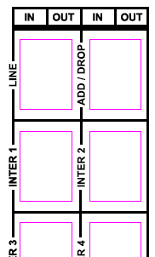
Directionless Interconnections
MUX
DEMUX
Site 1
Line IN
Line IN
Site 3, Direction B
Line IN
Site 2, Direction A
Line OUT
Line OUT
Line OUT
IN/OUT
IN/OUT
IN/OUT
IN/OUT
IN/OUT
IN/OUT
Direction B
Direction C
Direction A

Slide 25

Management of SC14
Controller API
(OpenDaylight)
REST
GUI
Padtec NMS
CLI
PPM3
Network Elements (NMSN mode)
RoadMap :
NE Features and constraints modeled in YANG, using Padtec YANG model
NE mode changed via Software Upgrade/Downgrade

Slide 26
Super Computing 2014 Results

Slide 27
SC14 Demo Results by Prof. Harvey Newman
We sustained 1.4 Tbps during our memory to memory warmups on the first day. The peak was 1.55 Tbps in and out of the Caltech booth. During the warm up we also had 1 Echostreams server doing a total of > 150G in and out of its two Mellanox NICs simultaneously. Disk to memory we reached a peak of 1.01 Tbps, reaching our goal. We have been able to sustain 940+ for long periods.
We sent and received 11 Petabytes of data to and from the Caltech booth. 3.7 Petabytes went over the wide area between New Orleans and Caltech, Victoria, Michigan, Sao Paulo and NERSC.
We had sustained flows of very close to 100G in one direction from UVic; and large flows often making up a big fraction of 100G to and/or from Caltech, UMich, and Sao Paulo. There were also new disk to disk and memory to memory records between the Northern and Southern hemispheres.
In terms of wide area traffic rates, we reached 370G sustained, and 310G for a long time, with a solid 100G (99.74G to UVic), up to 100G from Umich, and up to 93G from Caltech, 92.5G from the combination of CERN and Sao Paulo (via FLR), and 45G from NERSC.
Disk to disk was harder, because of problems which might have been due to the OS and/or what happens when you hit the CPUs as hard as we did. Nevertheless, we reached a peak of 340 Gbps peak and 300 Gbps sustained disk to disk. We will continue to investigate further and resolve the issues with the OS and/or with the controller, CPUs or other potential issues.
A lot was learned in terms of putting PhEDEx into larger scale use with circuits, and achieving more deterministic workflow in the large scale. Work on some of the built-in time delays, and perhaps on the central (single instance) database should continue, as part of getting the new PhEDEx paradigm out in the field.
There were also some successes with OpenDaylight, limited in part by the very short time available and the early state of the ODL Hydrogen release. We will move forward with the ODL controller's reactive mode using our own testbed facilities and our Brocade switches at Caltech and elsewhere.

Slide 28
Results
sustained 1.4 Tbps during our memory to memory;
peak was 1.55 Tbps;
Disk to memory we reached a peak of 1.01 Tbps;

Slide 29
Lightwave Online: Padtec demos SDN-controlled directionless ROADM at SC14
Harvey Newman of Caltech, professor of Physics and head of the SC14 team, said, "Padtec ROADMs and software behaved perfectly. Its ROADM and 100-Gbps transponders not only allowed an astounding 1 Tbps of data to flow during SC14 but also demonstrated how an external third-party OpenDaylight controller can be used to reconfigure topology on demand and provision the individual network components.”
Lightwave Online, “Padtec demos SDN-controlled directionless ROADM at SC14”, Nov 25th, 2014, url:
http://www.lightwaveonline.com/articles/2014/11/padtec-demos-sdn-controlled-directionless-roadm-at-sc14.html?cmpid=EnlDailyNovember252014.

Slide 30
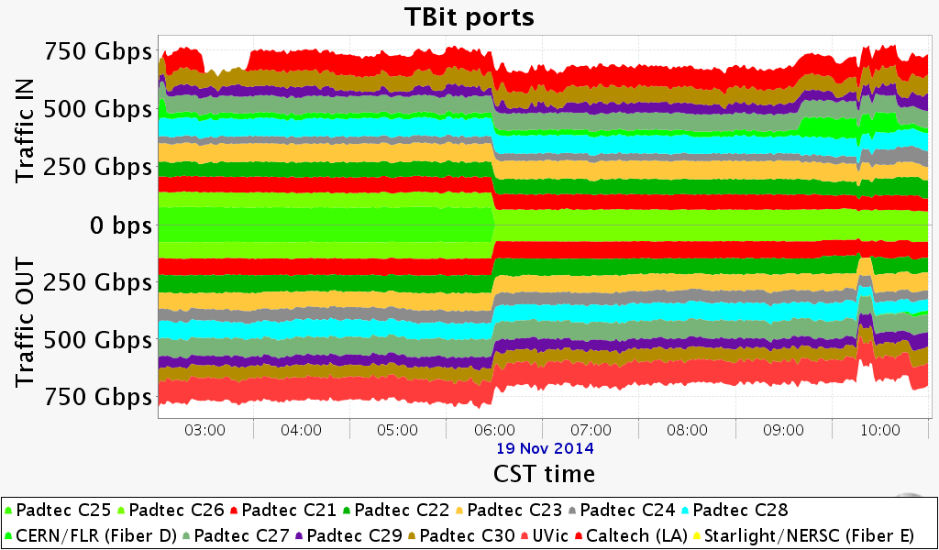
1.55 Tbps peak rate - memory to memory transfer

Slide 31
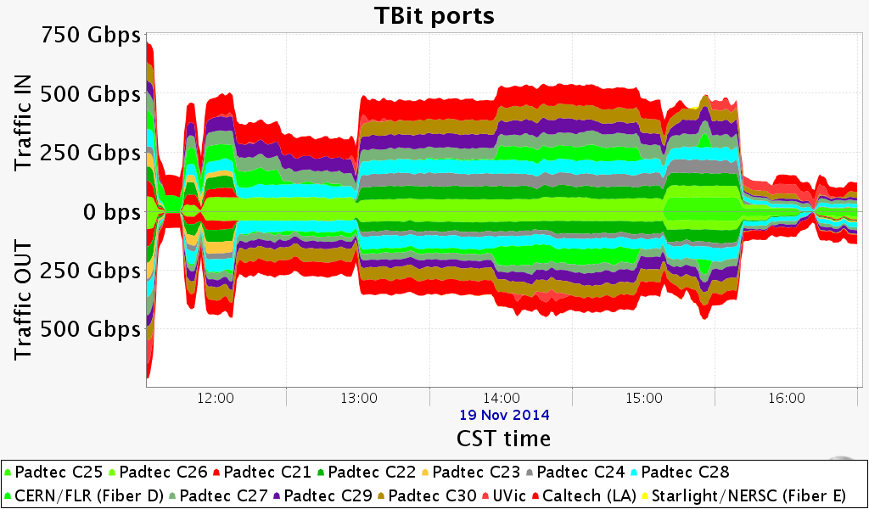
1 Tbps peak rate – disc to memory transfer

Slide 32
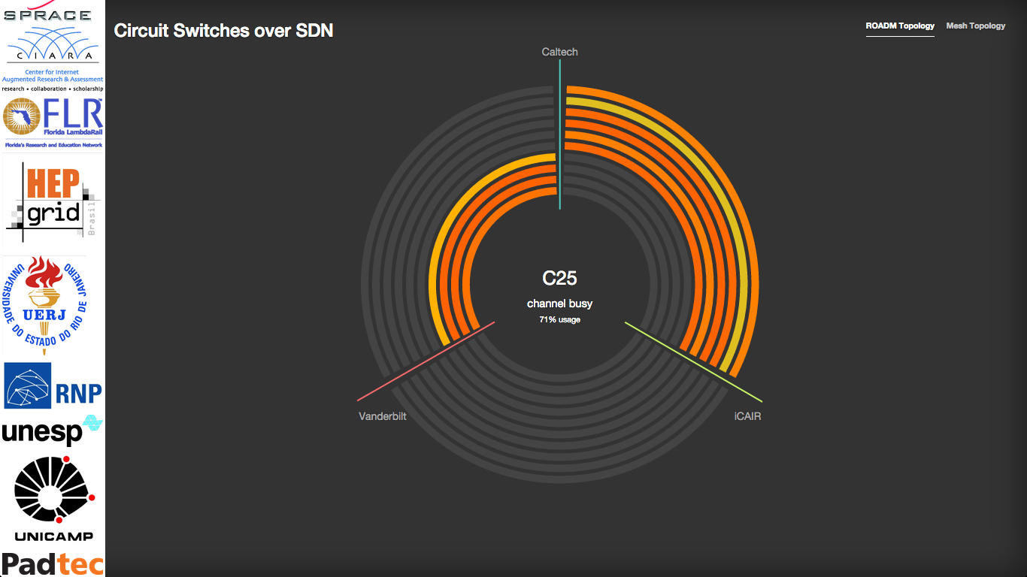
Load of the channels in the demo

Slide 33
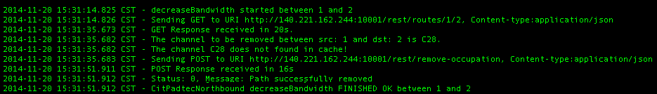
Performing a command to decrease the bandwidth between nodes 1 and 2
Console Client Log
OpenDayLight Controller Log

Slide 34
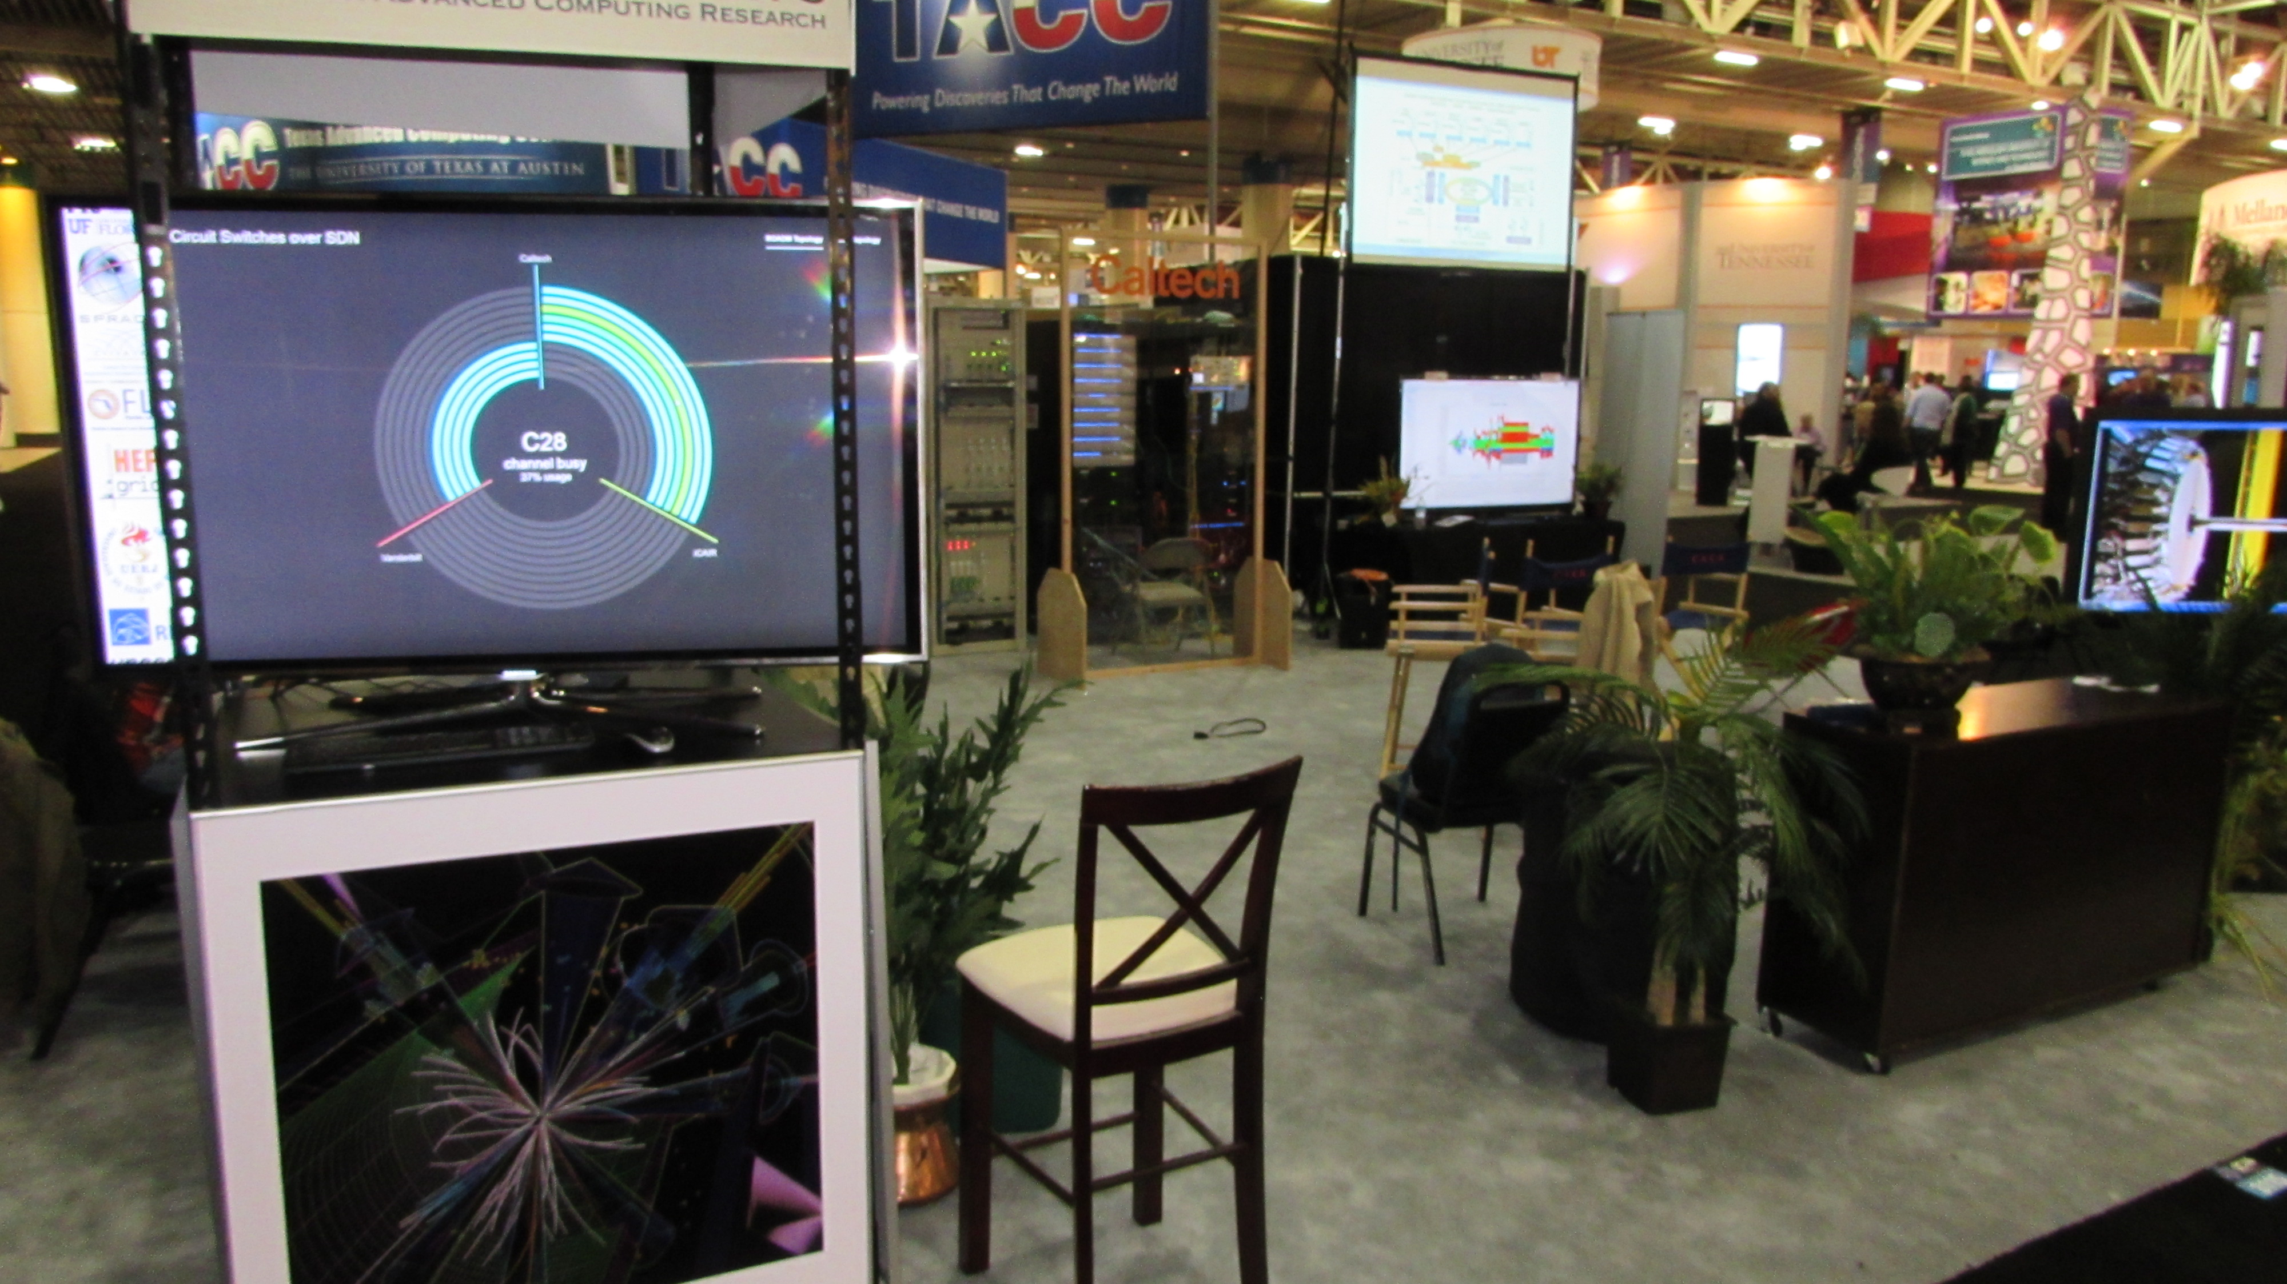
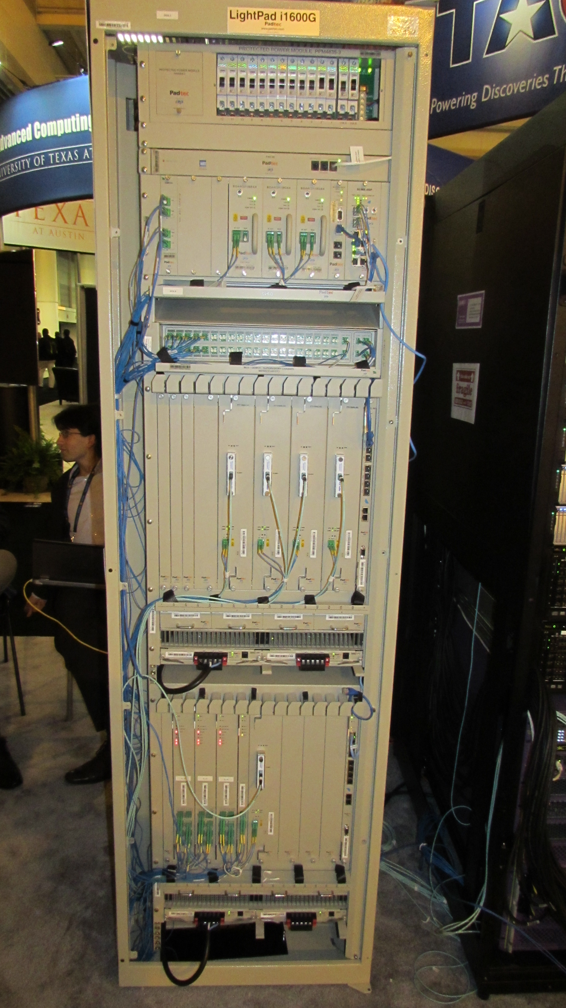
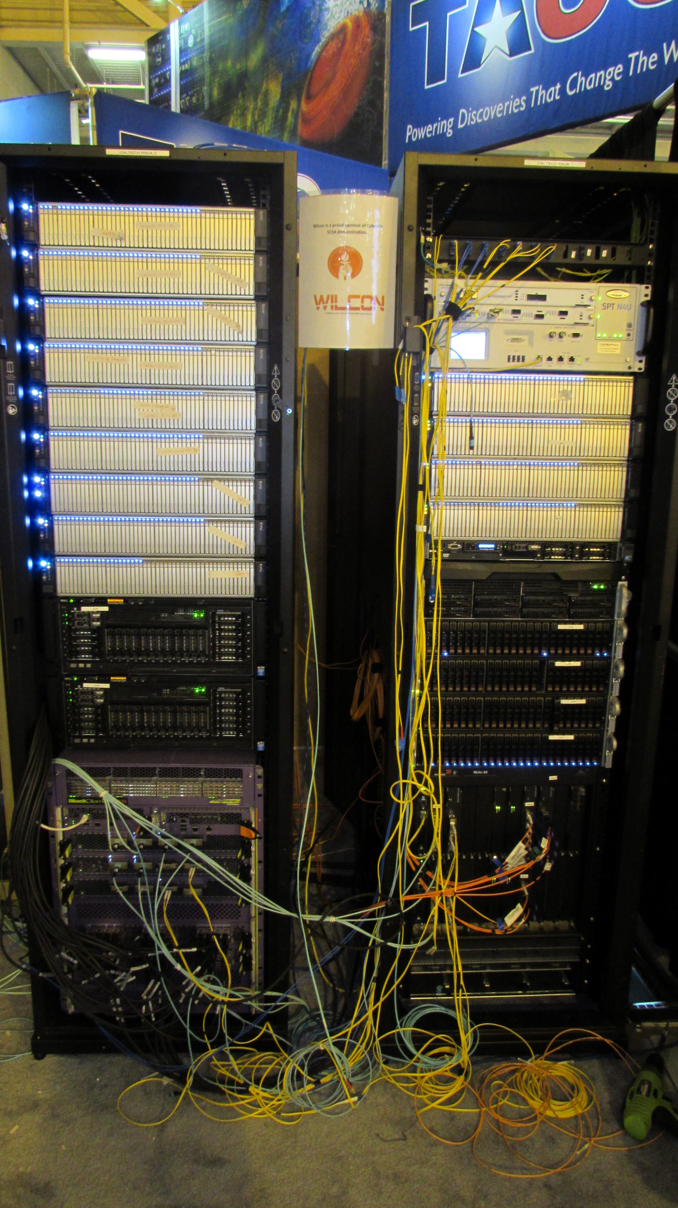
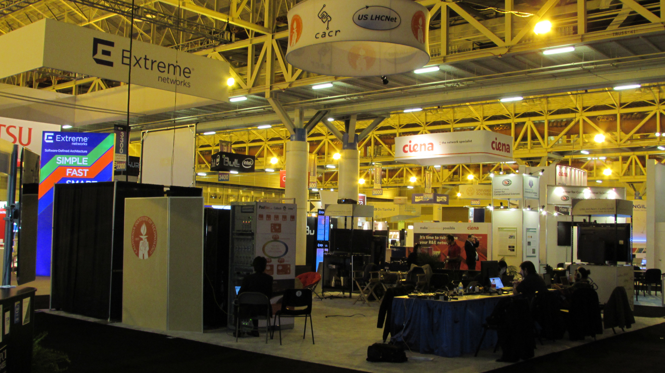
Pictures of the Caltech Booth
Padtec ROADM
Racks with EchoStream and Dell Servers, and
Extreme and Brocade Switches

Slide 35
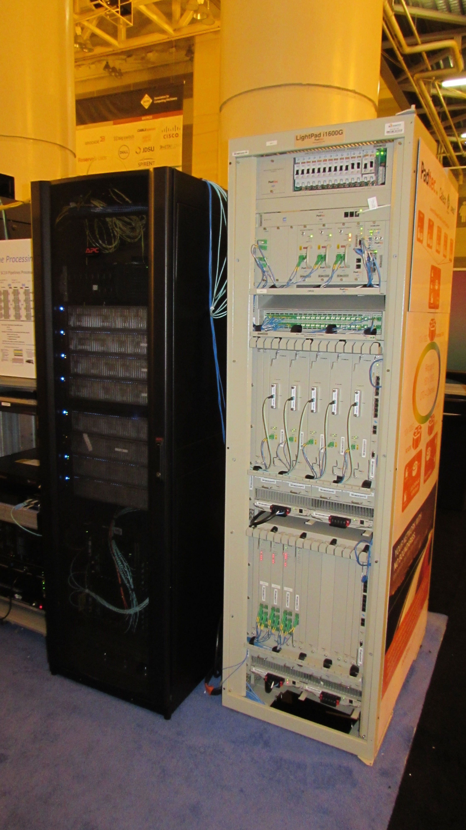
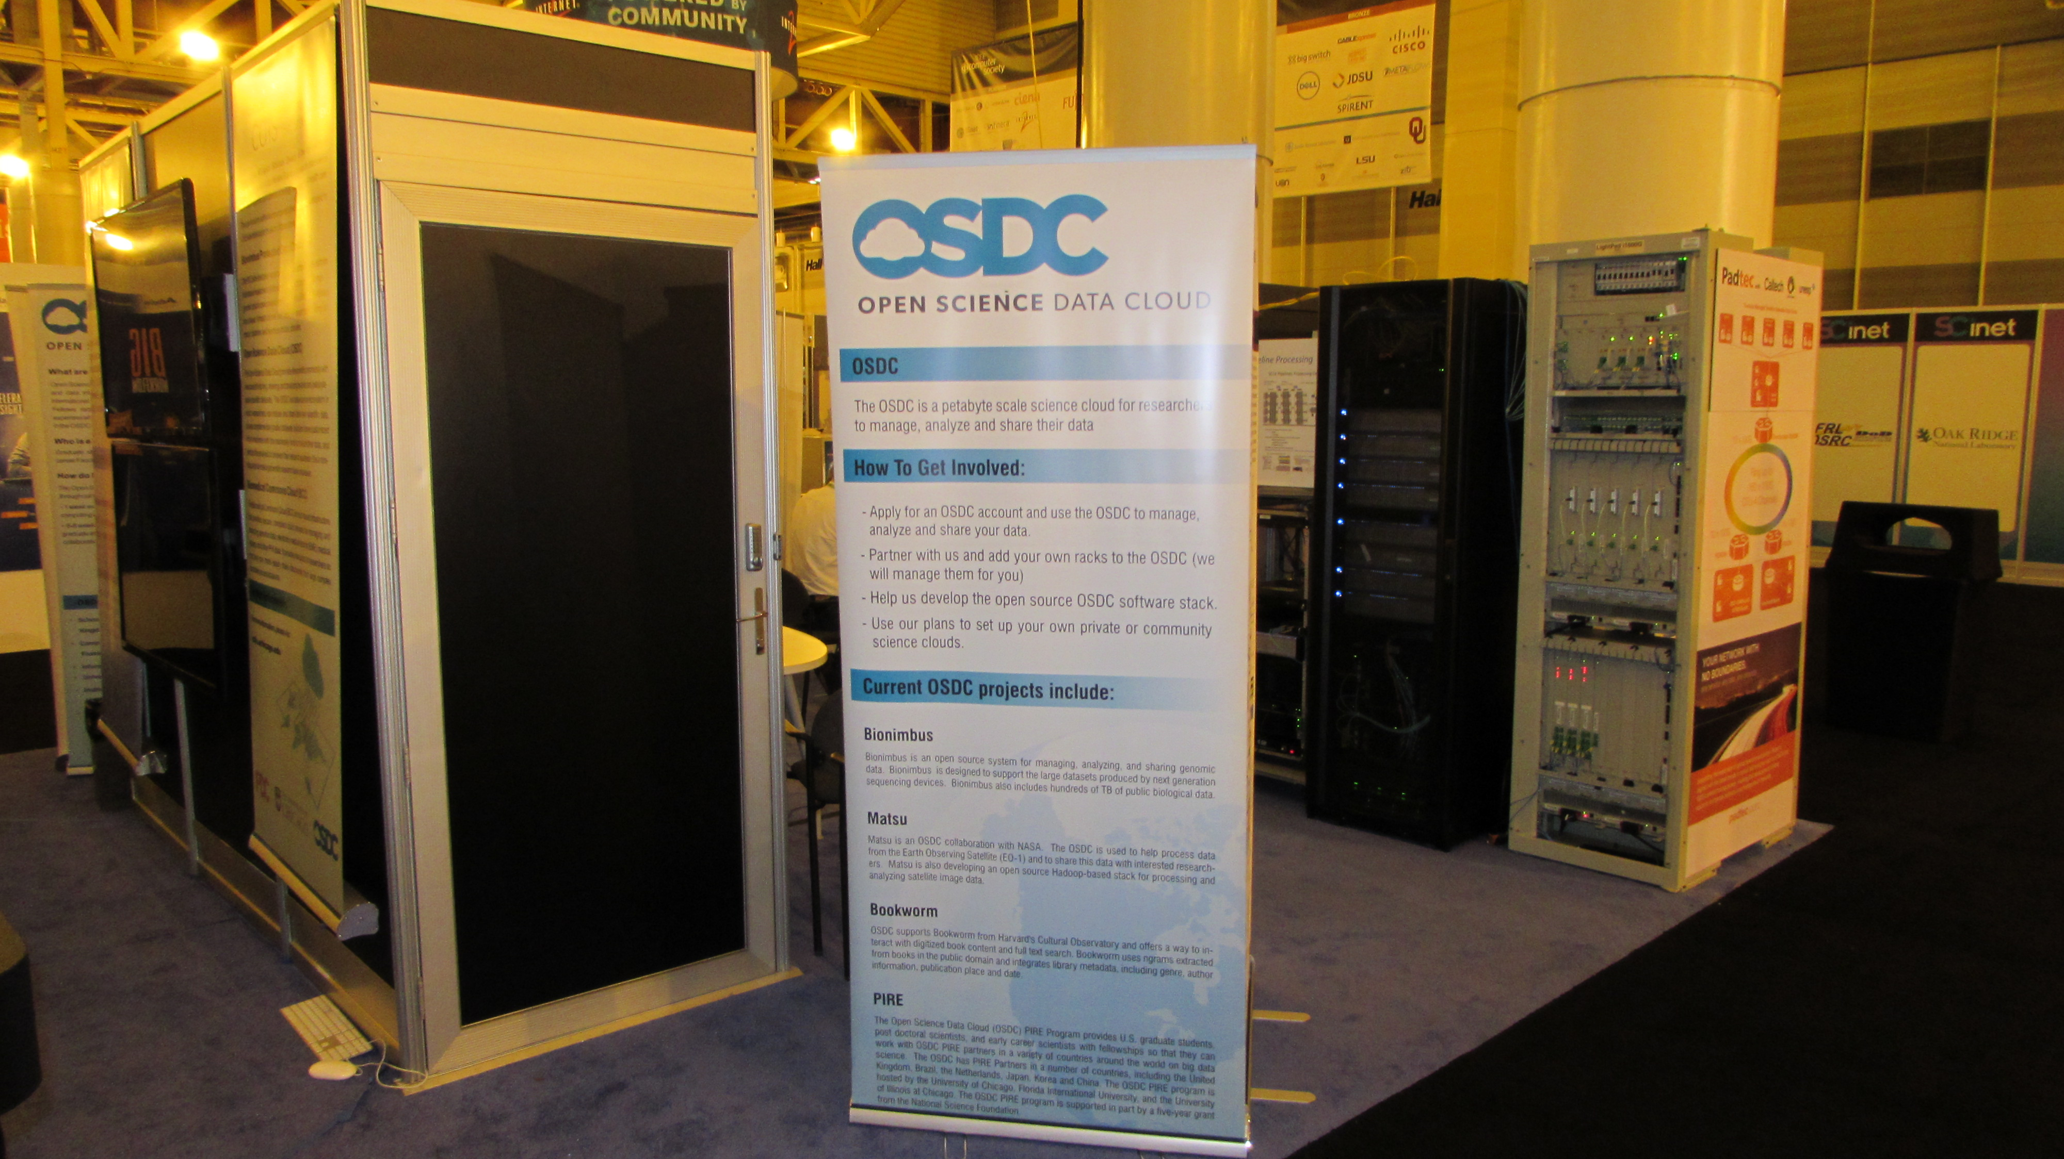
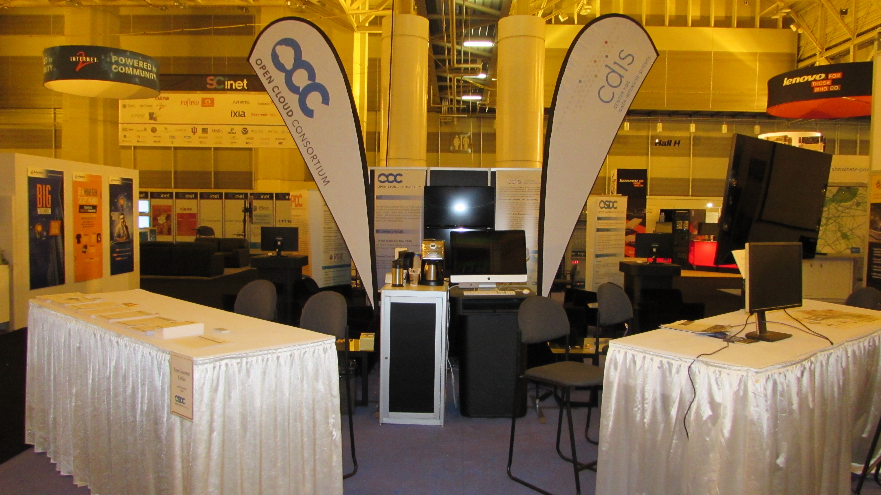
Pictures of the iCAIR Booth
Padtec ROADM
And Caltech’s Racks

Slide 36
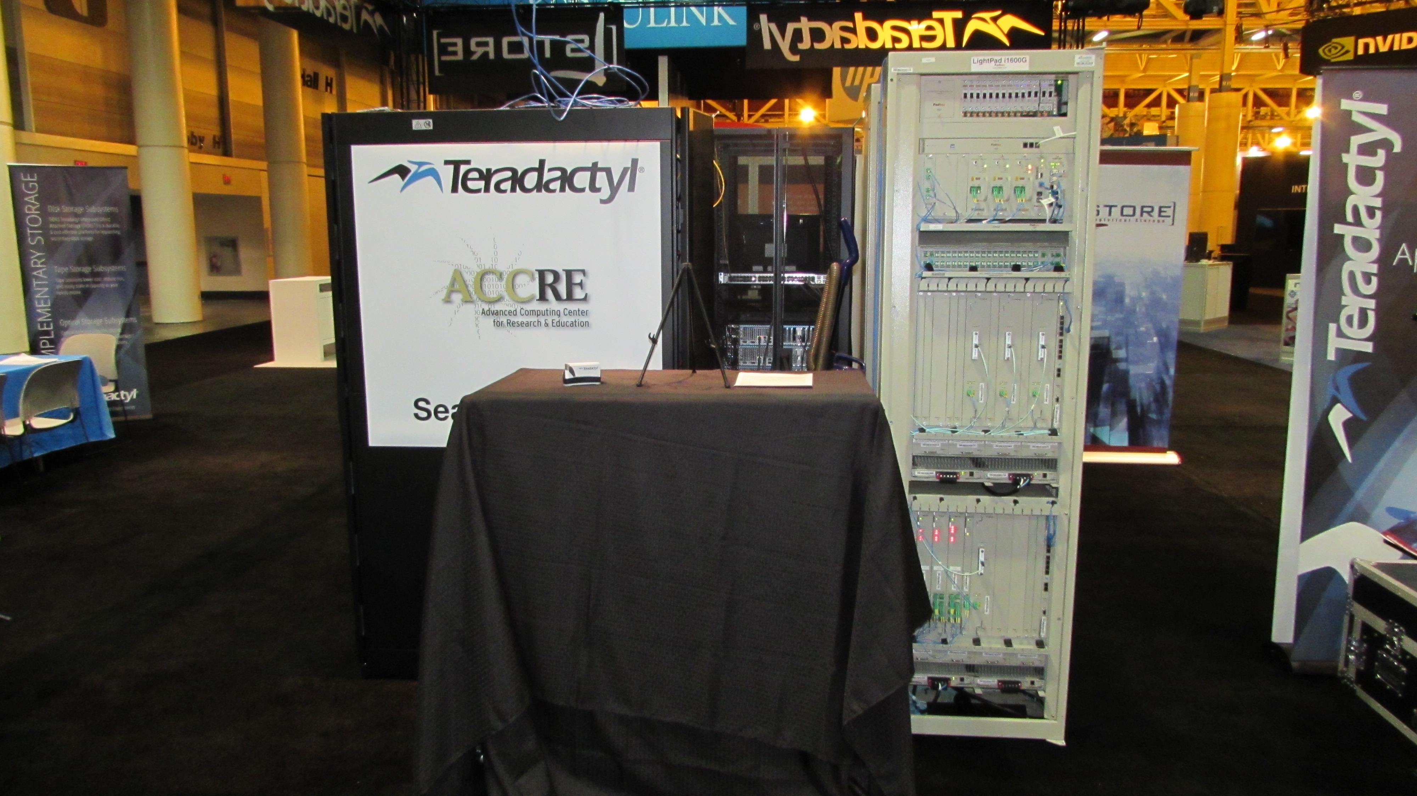
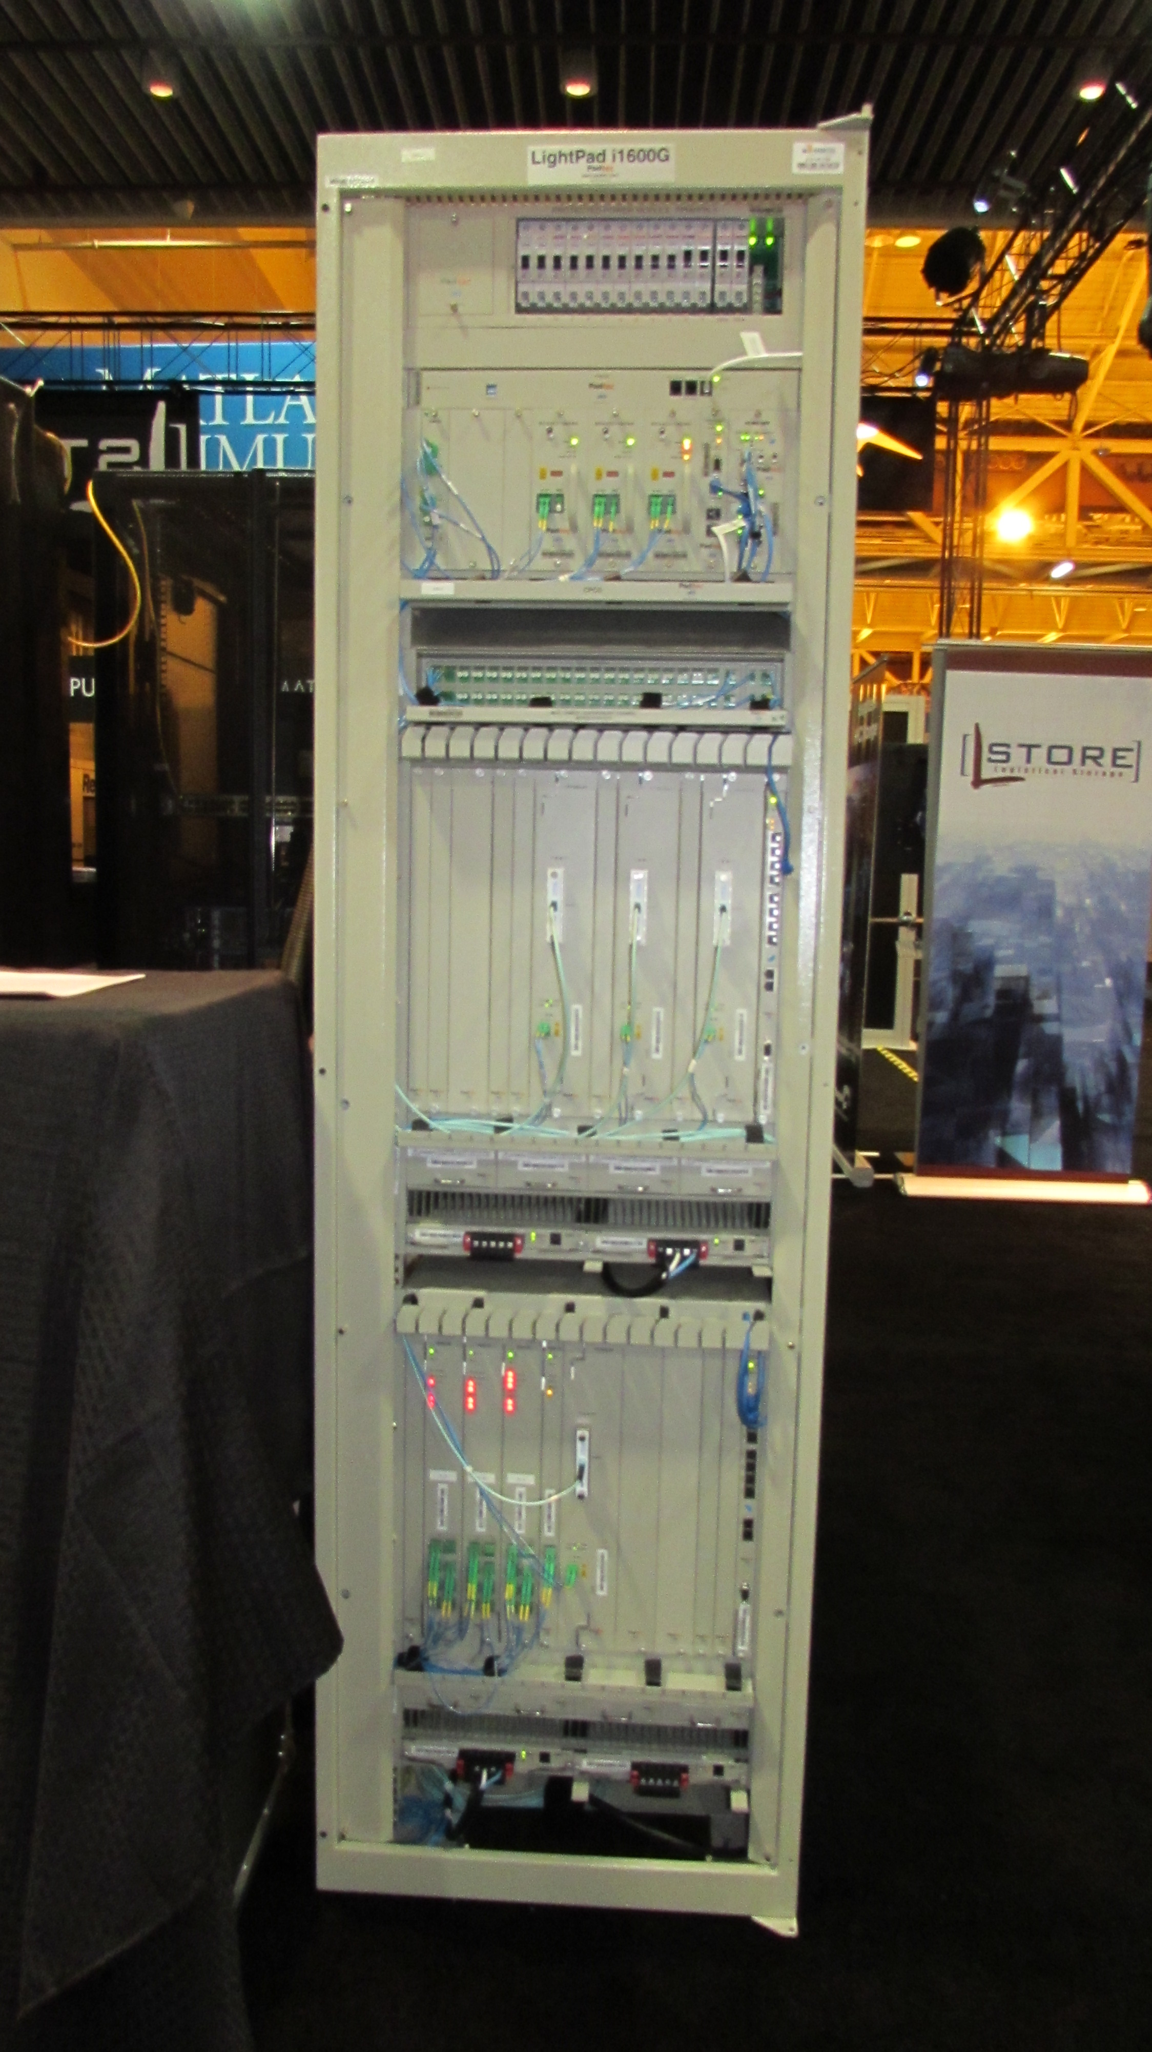
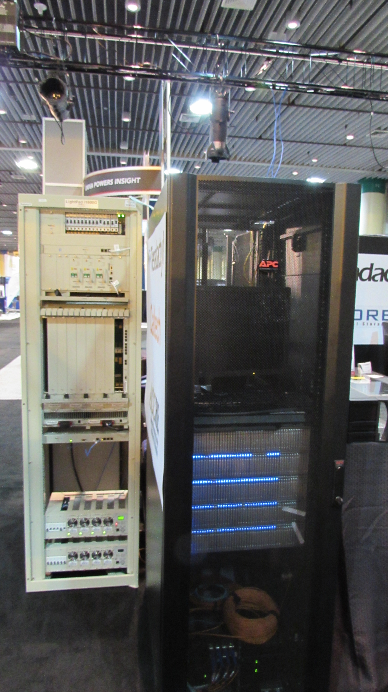
Pictures of the Vanderbilt Booth
Padtec ROADM

Slide 37
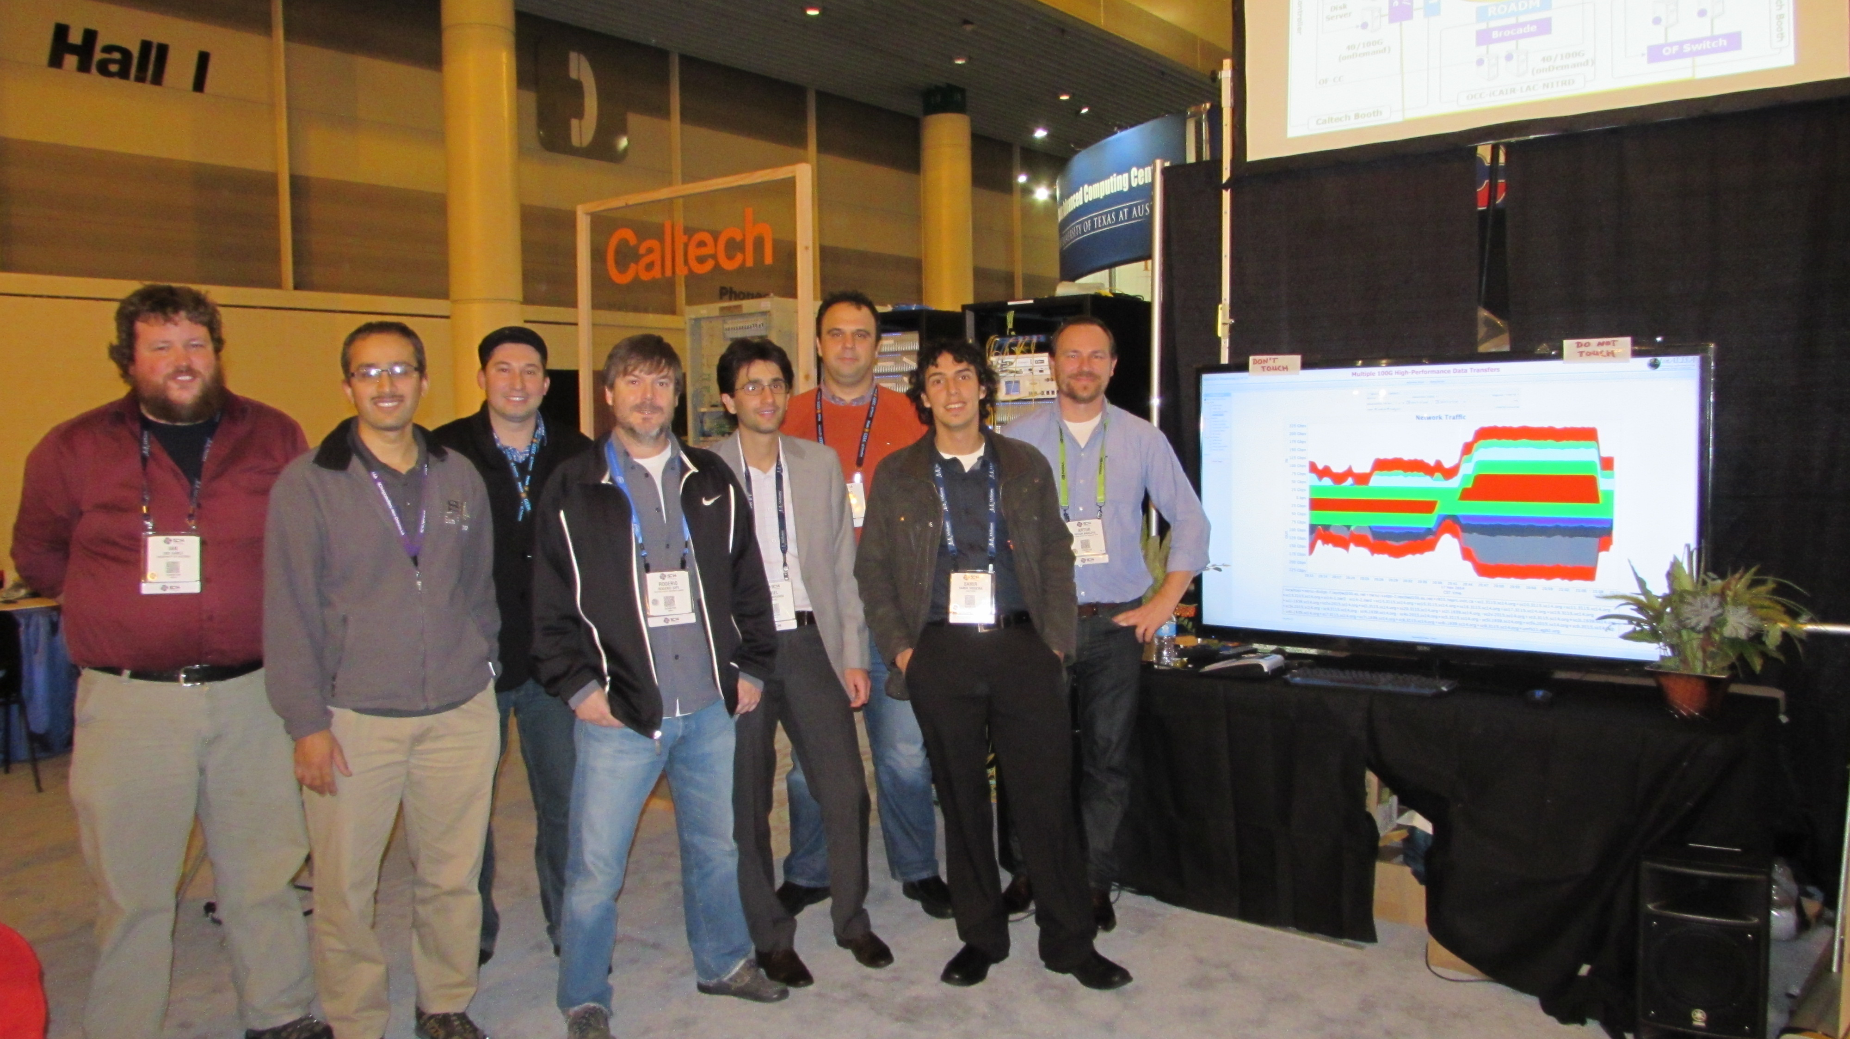
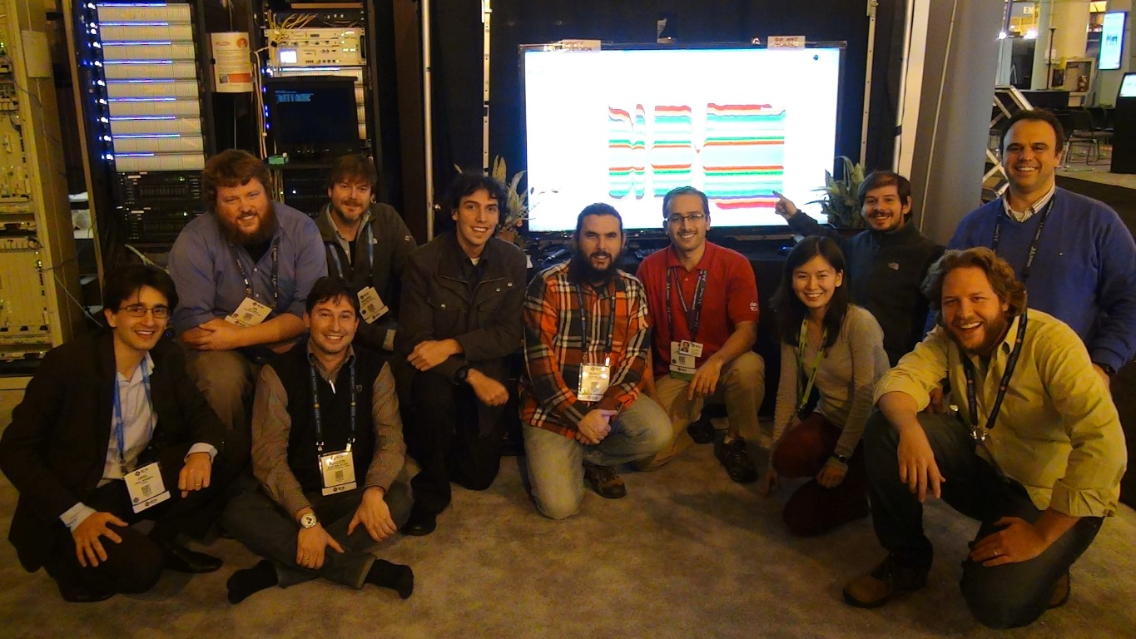
SC14 Team

